Slide 1
Innovation for Impact:
Real-World Problem Solving through Open Innovation
Speaker Biographies – Meet the team

Slide 2
In this presentation, you can meet the team behind this online course.
You can move through the slides by clicking the 'arrow' button.

Slide 3
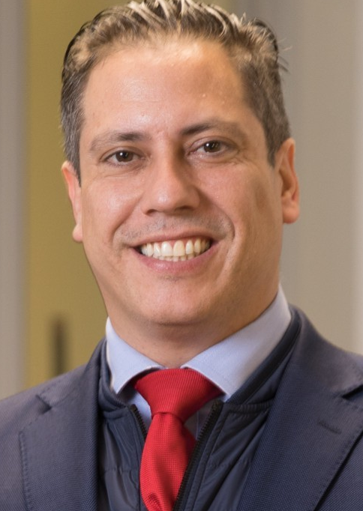
Dr Juan Martin
Dr Juan Martin, graduated as a doctor in Spain in 1999, PhD in Internal Medicine. Specialised in Biochemical Pathology and Intensive Care. MBA and LLD.
Started working for the UEL as Director of the Course of Innovation in 2025.
He also works as an Intensive Care Specialist in Newham University Hospital since 2013.
Lead of Research in Intensive Care and the most world awarded innovator in 2021 by Wazoku.

Slide 4
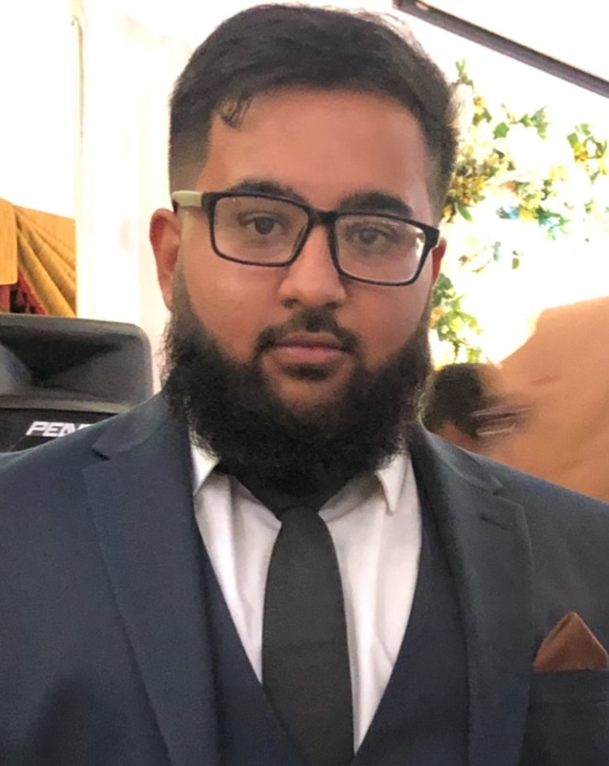
Tahmid Rudman Tarafder
Tahmid Rudman Tarafder – Graduate Project Manager, University of East London
Graduated in 2024 with a Bachelor’s degree in Business Management from UEL
Started in 2025 as a Graduate Project Manager, supporting project delivery, coordination, and stakeholder engagement
Strong interest in innovation, structured delivery, and continuous improvement

Slide 5
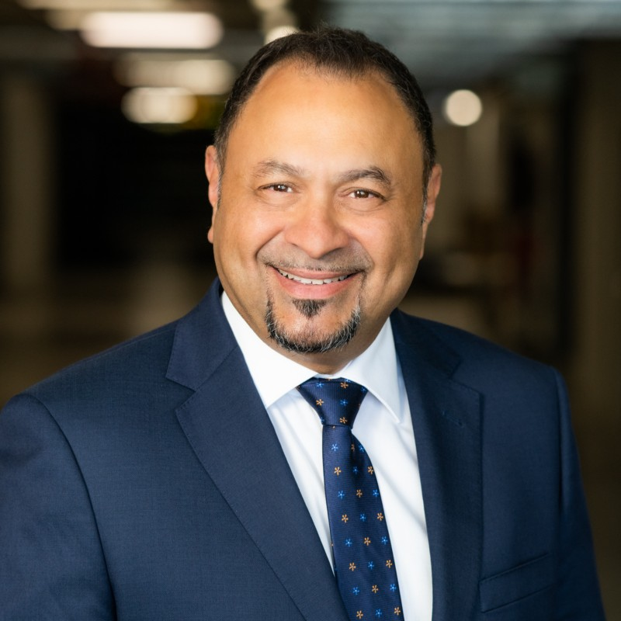
Professor Matt Bellgard
Professor Matt Bellgard – Pro Vice-Chancellor for Impact & Innovation at the University of East London
Leads UEL’s strategy on research impact, innovation, and industry engagement
Expert in AI, bioinformatics, and digital innovation with a strong record of applied research
Co-inventor of multiple patents and project director for the design and commissioning of a world’s top-100 supercomputer and led development of the APEC Rare Disease Action Plan endorsed by 21 governments

Slide 6
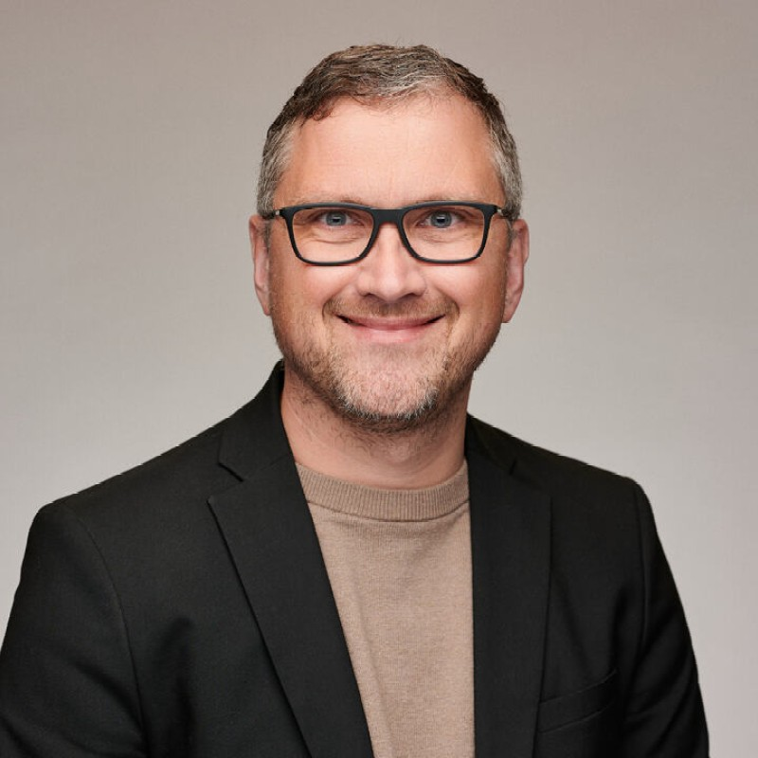
Simon Hill
Simon Hill – CEO & Co-Founder of Wazoku
Founded Wazoku in 2011, with the aim of helping organisations scale innovation through crowdsourcing
Over 10+ years leading global open-innovation and idea-management platforms used by governments and major enterprises
Awarded Guardian SME Leader of the Year (2016) for leadership in innovation and business growth

Slide 7
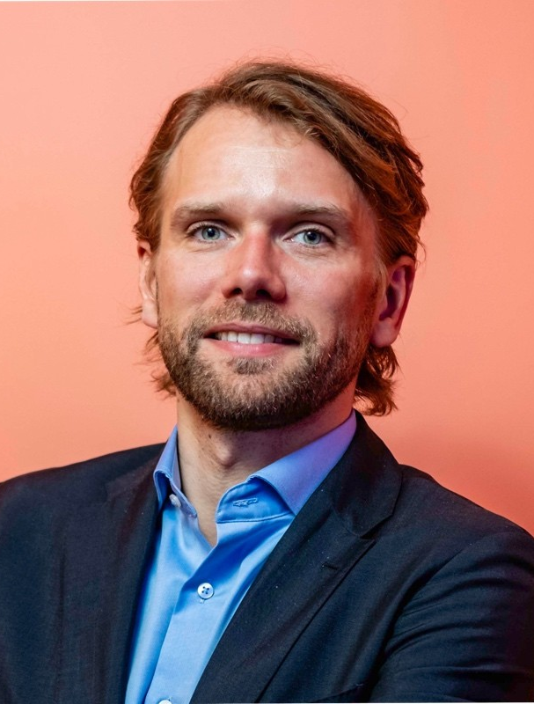
Schonning Eysturoy
Schønning Eysturoy – Senior Director, Innovation Ecosystems at Wazoku, leading strategic innovation initiatives globally
Focuses on building and expanding open-innovation ecosystems that help organisations share, scale and fund breakthrough ideas.
Drives partnerships and innovation programmes across sectors, including international collaboration events and support for innovators.
Spearheading strategic innovation ecosystem development at Wazoku during a period of global growth.

Slide 8
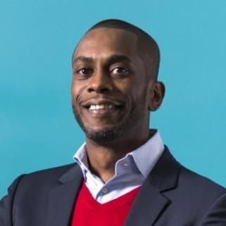
Dr Darren Sharpe
Dr Darren Sharpe – Associate Professor in Social Justice Studies at the University of East London
Deputy Director of the Institute for Connected Communities, leading community-focused research
Over 25 years’ experience in applied research around social justice, wellbeing, and participation
Winner of UEL’s VC&P Global Engagement Award and PVC for Impact & Innovation Award (2021)

